Slide 1
Day to Day
Technical Training Session
Company: Techzenure
Mentor : Ram Kumar

Slide 2
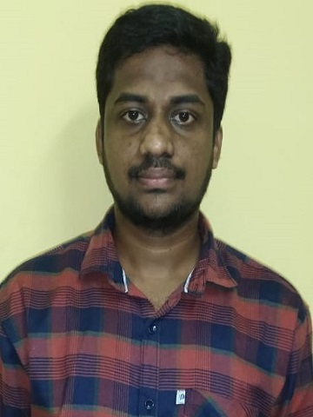
Techzenure training presentation
Presented by:-
Name: Pemmasani Vikas
Employee No:- 36
Position: SDE - 1
Company: Techzenure
Email Id: vikas.p@techzenure.com

Slide 3
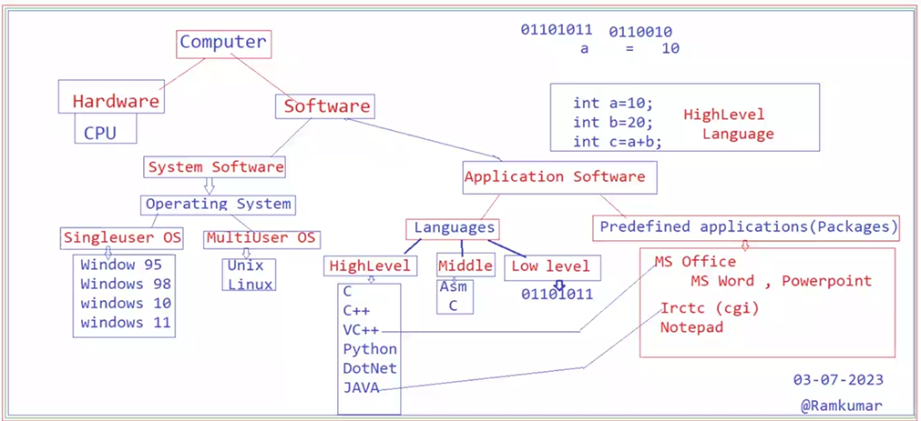
03/07/2023
Day 1: Basics of computer

Slide 4
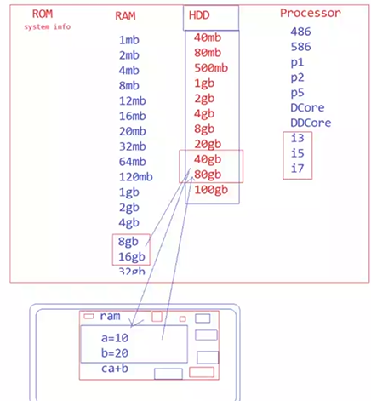
03/07/2023
Day 1: RAM, ROM, HDD And PROCESSOR

Slide 5
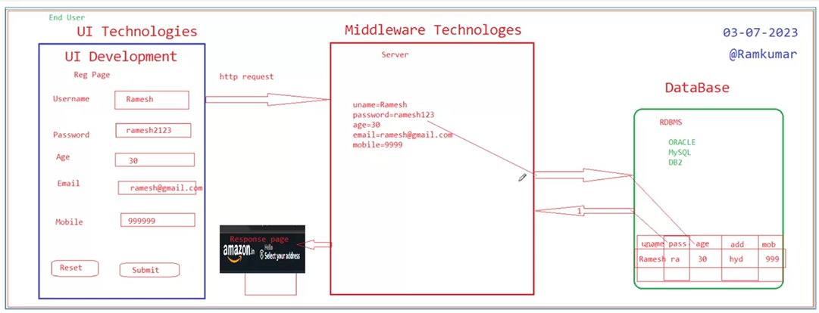
04/07/2023
Day 2: Three Tier Architecture Model

Slide 6
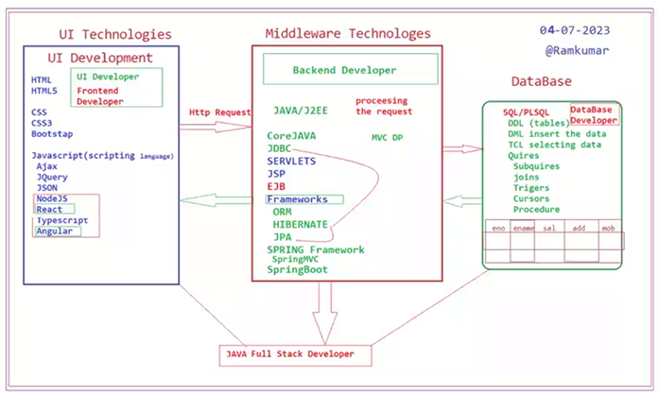
03/07/2023
Day 2: Java Full Stack Developer Overview

Slide 7
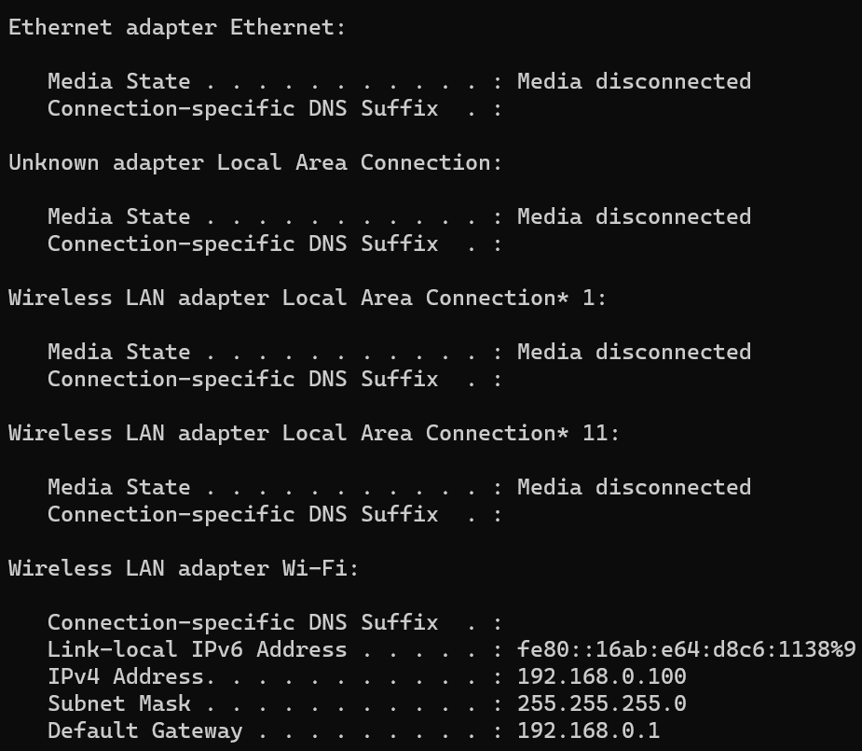
05/07/2023
Day 3: System Configuration

Slide 8
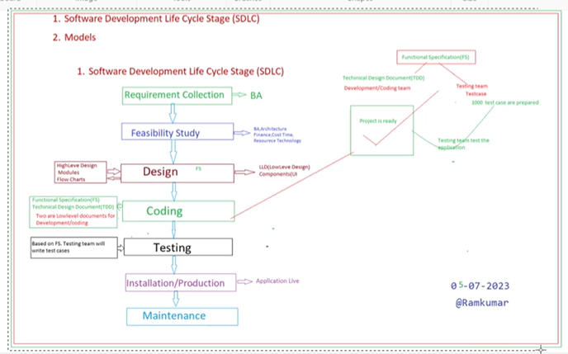
05/07/2023
Day 3 : Software Development Life Cycle Stages(SDLC )

Slide 9
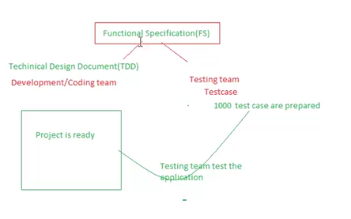
Test cases
Day - 3
05/07/2023

Slide 10
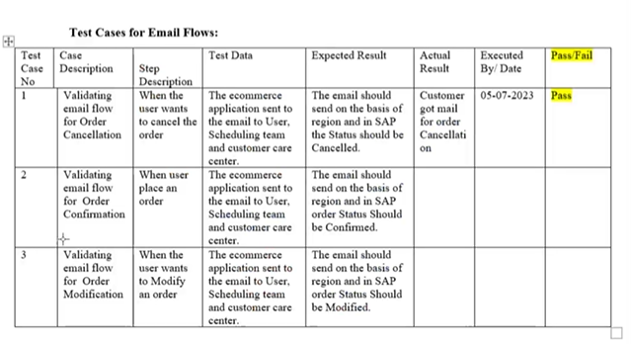
05/07/2023
Day 3: Test Cases for Email

Slide 11
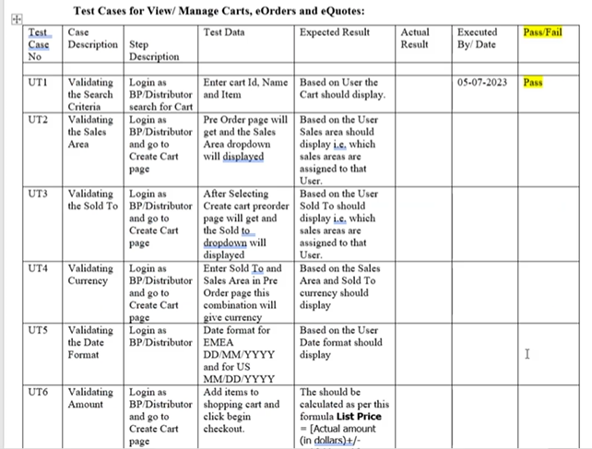
05/07/2023
Day 3: Test cases

Slide 12
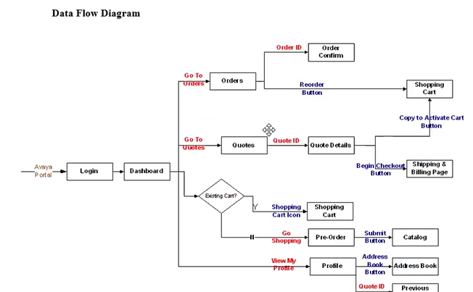
Data flow Diagram
DAY - 3
05/07/2023

Slide 13
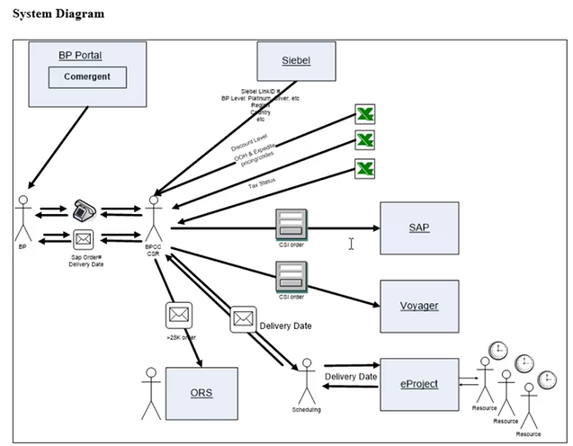
System Diagram
Day - 3
05/07/2023

Slide 14
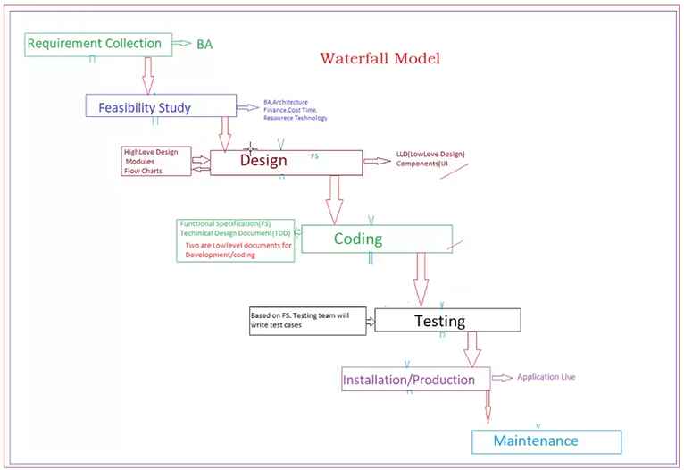
Waterfall Model
Day - 4
06/07/2023

Slide 15
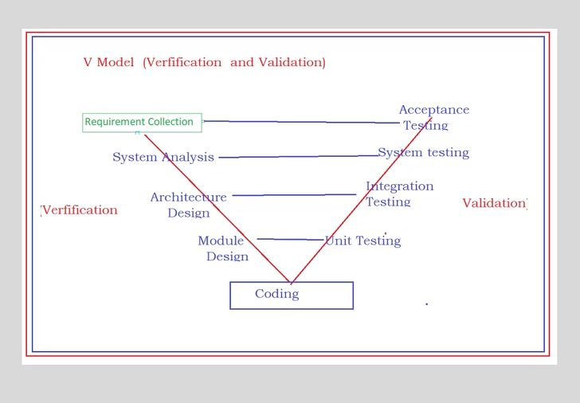
V Model
DAY - 4
06/07/2023

Slide 16
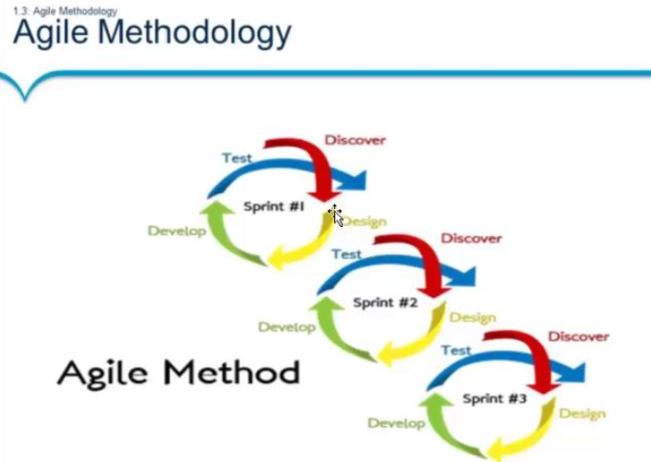
Agile Methodology
Day - 4
06/07/2023

Slide 17
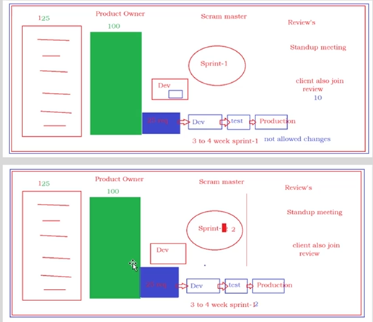
Agile Model
Day - 4
06/07/2023

Slide 18
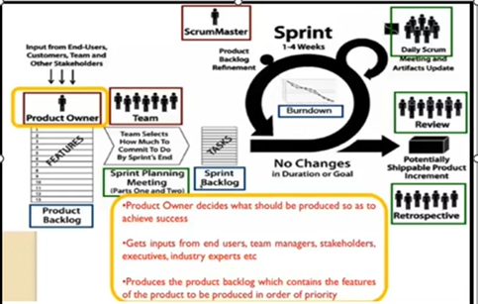
06/07/2023
Day 4: Sprint 1 to 4 weeks Planning

Slide 19
Agile Model Explanation
Day - 4
06/07/2023
Sprint-1 3 to 4 week - 25%
Sprint -2 3 to 4 week - 25%
Sprint -3 3 to 4 week - 25%
Sprint – 4 3 to 4 week - 25%
While time started sprint-1 don’t allow changes up to end sprint-1.
After sprint-1 completing the sprint-2 will start.
Daily Scrum meeting and review.

Slide 20
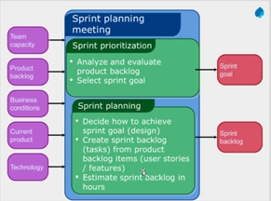
Sprint Planning meeting
Day - 4
06/07/203

Slide 21
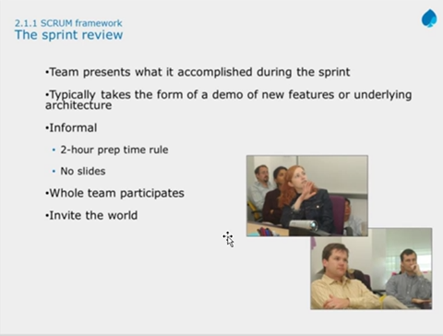
The Sprint Review
Day - 4
06/07/2023

Slide 22
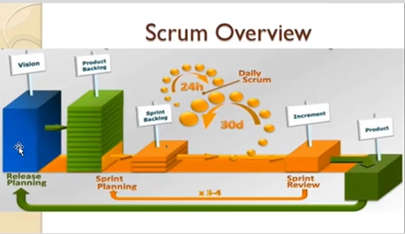
Scrum Overview
Day - 4
06/07/2023

Slide 23
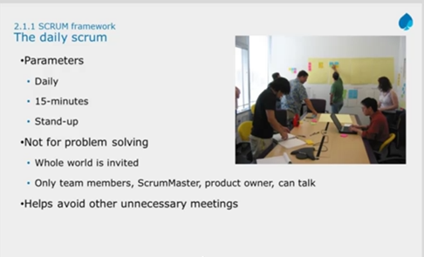
Daily Scrum framework
Day - 4
06/07/2023

Slide 24
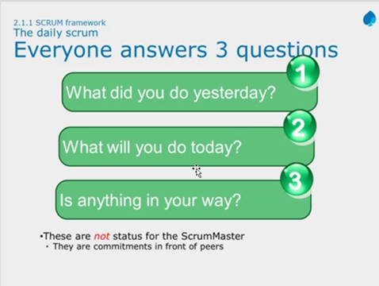
The Daily Scrum
Day - 4
06/07/2023

Slide 25
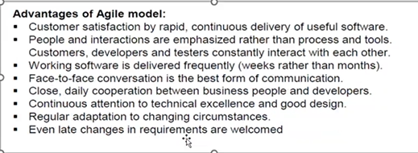
Advantages of Agile model

Slide 26
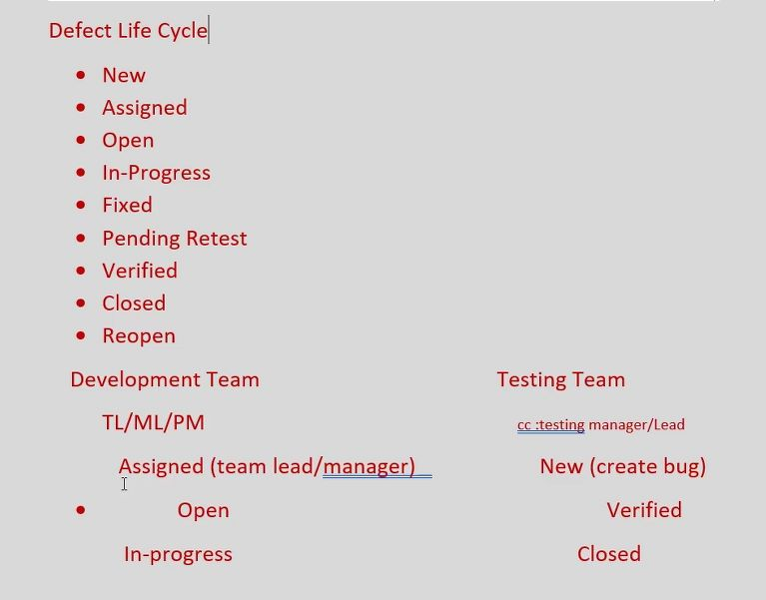
Day 4: Defect/Bug Life Cycle
06/07/2023

Slide 27
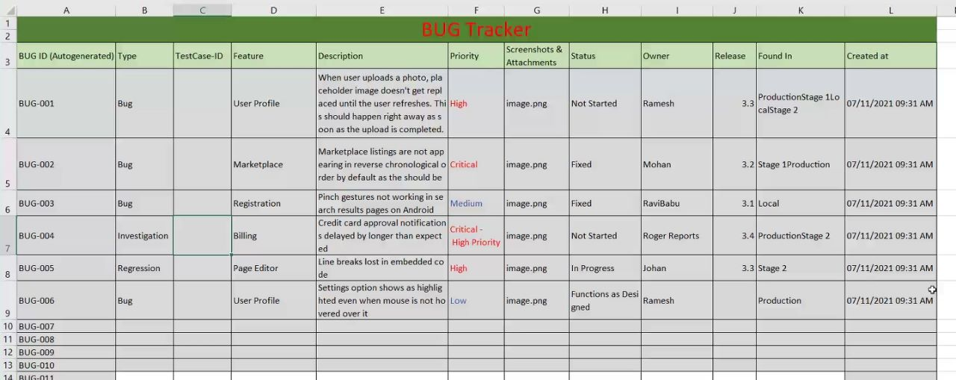
07/07/2023
Day 5: Bug Tracker Report

Slide 28
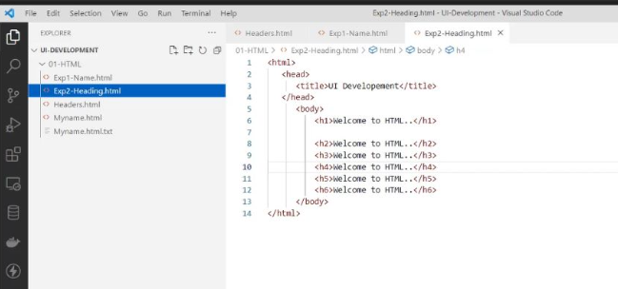
07/07/2023
Day 5: Downloaded Visual Studio Code

Slide 29
Thank you

